Slide 1



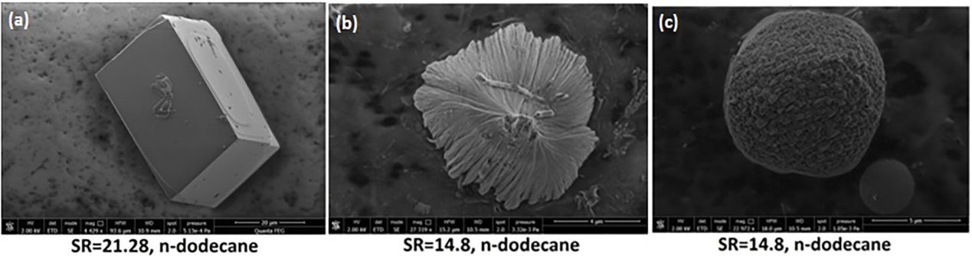
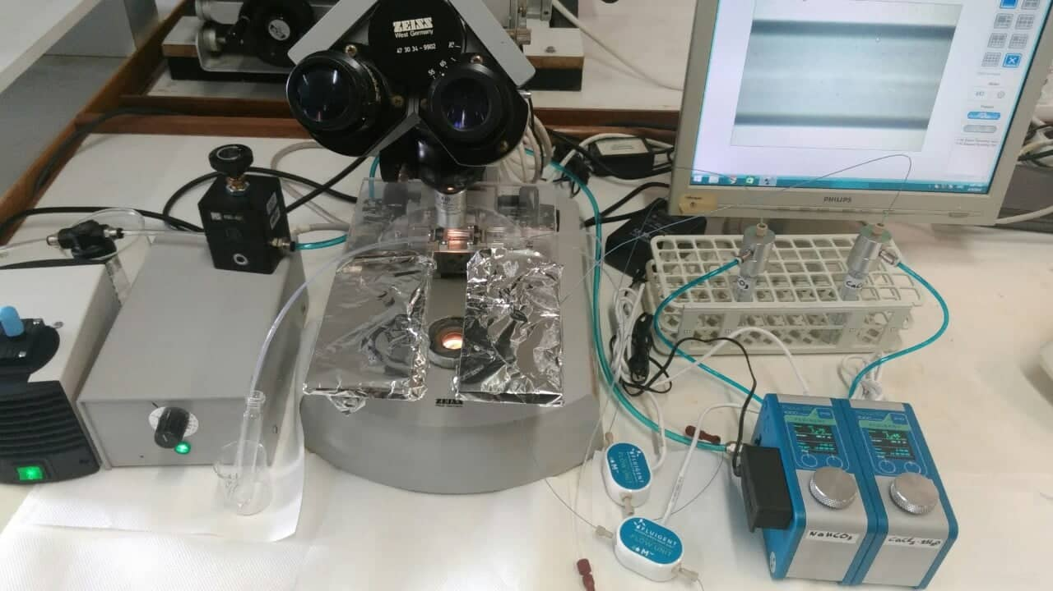
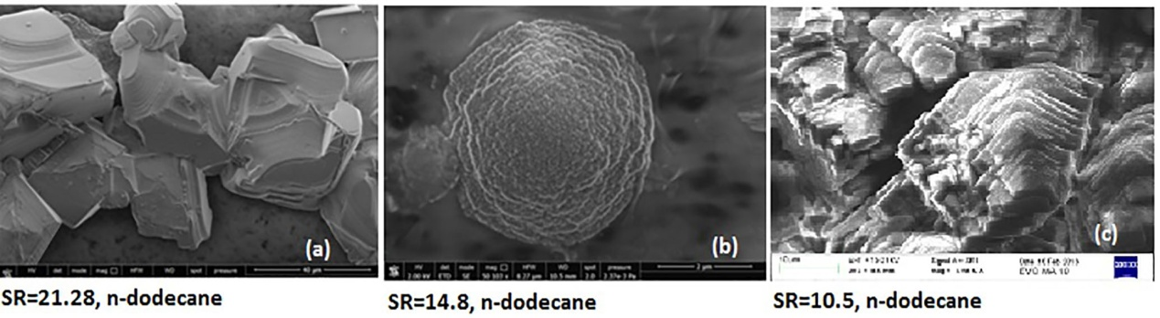

VISUALIZATION EXPERIMENTS OF SALT PRECIPITATION IN HOMOGENEOUSLY-WET MICROCHANNELS
Andreas Tzachristas (1,2), Roxani-Eirini Malamoudi (2), Dimitra G. Kanellopoulou (1,2), Christakis A. Paraskeva (1,2), Petros G. Koutsoukos (1,2), Varvara Sygouni (1,2)
(1) Institute of Chemical Engineering Sciences, Foundation for Research and Technology Hellas (FORTH/ICE-HT), 26504, Patras, Greece
(2) Department of Chemical Engineering, University of Patras, 26504, Patras, Greece
Abstract
Methods and Materials
Multiphase ﬂow processes taking place during Enhanced Oil recovery (EOR), CO₂ or gas storage, geothermal energy production and utilization, membrane ﬁltration processes etc. are usually accompanied by undesirable phenomena of scaling. Salt precipitation results in the decrease of the local permeability of the porous medium and consequently in operational problems. In this work, we study salt precipitation (CaCO₃) in homogeneously–wet microchannels of Y-junction. The effect of pore surface wettability on calcium carbonate precipitation is investigated by performing visualization experiments in hydrophobic and hydrophilic microchannels.
Two soluble salts, NaHCO₃ and CaCl₂.2H₂O are injected separately in the microchip. The two fluids are mixed at the entire of the microchip. The solutions are injected using microfluidic devices (Flow EZ Fluigent).
SEM pictures of precipitated (a) calcite (SRinitial = 21.28), (b) aragonite (SRinitial = 14.8), and (c) vaterite (SRinitial = 14.8), in the presence of n-dodecane; 25 °C, IS = 0.15 M NaCl (Jaho et al.,2016)
Introduction
During past decades, sparingly soluble salt precipitation mechanisms have been investigated in relation with several parameters such as pH, temperature, ionic composition, the presence of additives in the supersaturated ﬂuids, the presence of seeds etc. [1,2,3]. Moreover, in the case of calcium carbonate precipitation in porous media, recent experimental results showed that the presence of organic solvents (water miscible and immiscible e.g. oil phase) inﬂuence strongly the salt precipitation mechanisms and crystal growth [4,5]. During salt precipitation in porous media, the presence of immiscible oil phase was found to accelerate crystal formation at the interfaces of oil-water [4]. Usually, for the visualization of multiphase flow, 1-D and 2-D porous media are used. Nevertheless, the past 10 years, the international research community focusing on multiphase flow and physicochemical processes, made a turn to microfluidics. Contemporary technology of microchips, cameras and microprocessors offers the possibility to visualize ever smaller volumes and obtain a more detailed and representative view of the basic physics of fluids and the underlying physicochemical mechanisms in a microscopic or mesoscopic level. Microfluidics is concerned with the flow of very small fluid volumes (10⁻³ to 10⁶ μm³) in channels with dimensions less than a few hundred of micrometers, thus reaching phenomena and processes at the molecular level^{[6]}.
SEM pictures of precipitated CaCO₃ in the presence of n-dodecane (a), (b) aggregates (c) rhombohedral calcite crystals with steps; SR_{initial}=10.5, 14.8 and 21.28, 25 °C, IS=0.15 M NaCl. (Jaho et al.,2016)
Microchannel Geometry
Future Steps
Dimensions
Length:25.5 mm
Width 15.0 mm
Depth 4 mm
Detailed investigation of crystal growth during salt precipitation in the presence and in the absence of organic compounds both water-miscible and water immiscible (n-dodecane).
Characterization of the crystals formed in the experimental system shall be done with Raman spectroscopy.
Pictures taken by https://www.dolomite-microfluidics.com/.
Experimental Conditions
Acknowledgements
Flow rate 1,5 μL / min for each solution.
T = 25 ⁰C
Re=0,57
Hydrophilic (Contact angle θ=0^{ο}), Hydrophobic microchips (Contact angle θ=180^{ο}).
We acknowledge support of this work by the Project “WetμFluid” (Code 172) which is implemented under the Action “1st Call for H.F.R.I. Research Projects for the support of Post-doctoral Researchers” funded by Hellenic Foundation for Research and Innovation.
References
Measurements
Avraam D G, Payatakes AC (1995). Journal of Fluid Mechanics 293, 2 (25): 207.
Moghadasi J, Muller-Steinhagen H, Jamialahmadi M., Sharif J (2004). Petroleum Sci. Eng. 43 (3-4): 201.
Koﬁna A N, Lioliou M G, Paraskeva CA, Klepetsanis P G, Østvold T, Koutsoukos PG (2009). Crystal Growth and Design, 9 (11): 4642.
Jaho S, Sygouni V, Rokidi SG, Parthenios J, Koutsoukos PG, Paraskeva CA (2016). Cryst. Growth Des., 2016, 16 (12): 6874–6884.
Pavlakou E I, Sygouni V, Lioliou M G, Koutsoukos PG, Paraskeva CA (2016) Cryst. Res. Technol.51 (2), 167–177.
Whitesides M George(2006) Nature, 2006, 368-372.
Snapshots of crystal growth and crystal’s size measurement using image analysis
[Ca²⁺] estimation using AAS

